Slide 1
10.5
Secant Lines and Segments

Slide 2
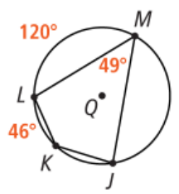
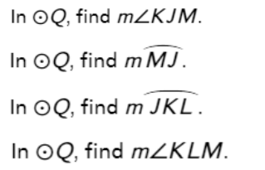
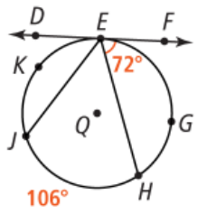
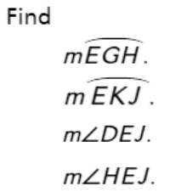
Warm Up – Give these a try…

Slide 3
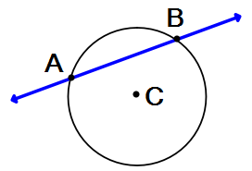

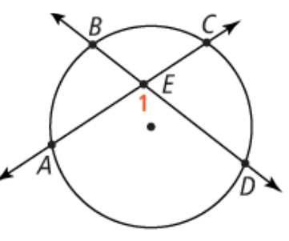
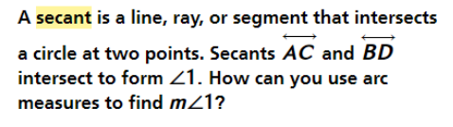
10.5 Secant Lines and Segments
**Don’t forget to add all definitions and theorems in your spiral
Secant - A line, ray, or segment that intersects a circle at two points

Slide 4
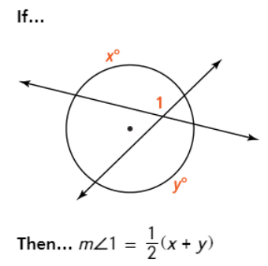
Theorem 10-10 Intersecting Chords(Secant) Theorem
The measure of an angle formed by two secant lines that intersect inside a circle is half the sum of the measures of the intercepted arcs.

Slide 5
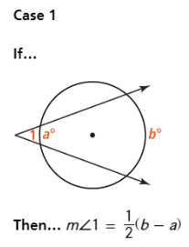
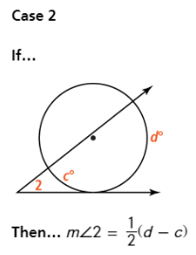
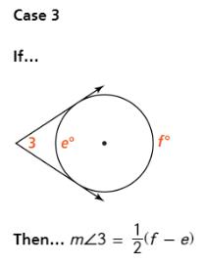
Theorem 10-11 Intersecting Secants Theorem
The measure of an angle formed by two lines that intersect outside a circle is half the difference of the measures of the intercepted arcs.

Slide 6
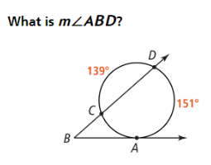
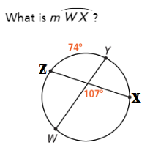
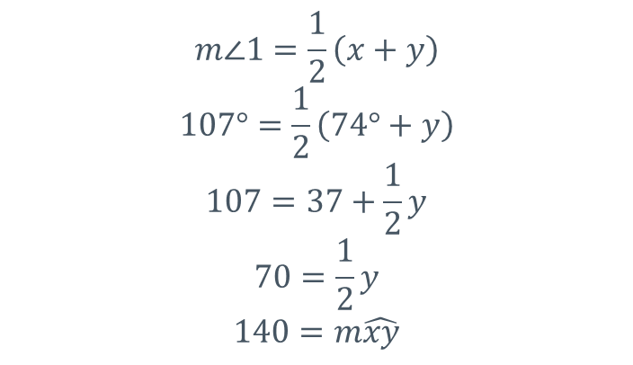
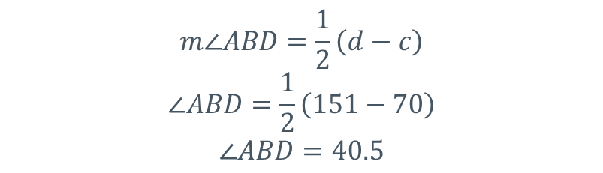
Examples 1 and 2:
70
$$m∠ABD=\frac{1}{2}\left(d−c\right)$$
$$∠ABD=\frac{1}{2}\left(151−70\right)$$
$$∠ABD=40.5$$
$$m∠1=\frac{1}{2}\left(x+y\right)$$
$$107°=\frac{1}{2}\left(74°+y\right)$$
$$107=37+\frac{1}{2}y$$
$$70=\frac{1}{2}y$$
$$140=m\hat{xy}$$

Slide 7
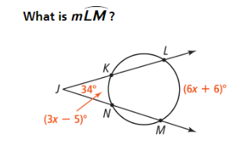
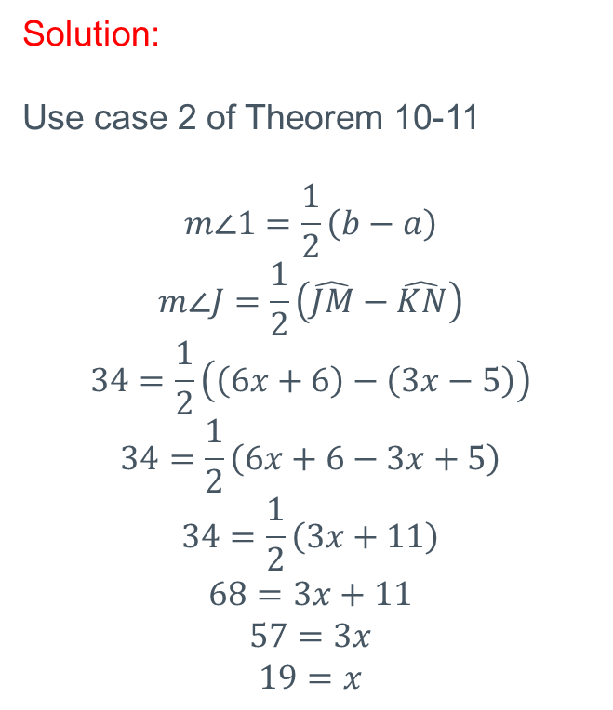
Example 3:
Solution:
Use case 2 of Theorem 10-11
$$m∠1=\frac{1}{2}\left(b−a\right)$$
$$m∠J=\frac{1}{2}\left(\hat{JM}−\hat{KN}\right)$$
$$34=\frac{1}{2}\left(\left(6x+6\right)−\left(3x−5\right)\right)$$
$$34=\frac{1}{2}\left(6x+6−3x+5\right)$$
$$34=\frac{1}{2}\left(3x+11\right)$$
$$68=3x+11$$
$$57=3x$$
$$19=x$$

Slide 8
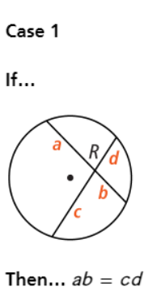
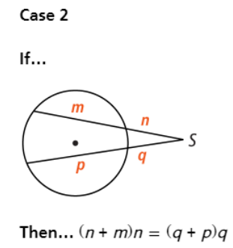
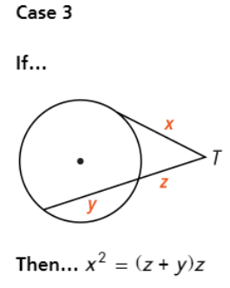
Theorem 10-12
For a given point and circle, the product of the lengths of the two segments from the point to the circle is constant along any line through the point and circle. `

Slide 9
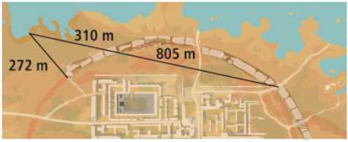
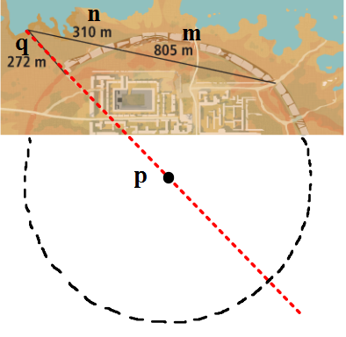
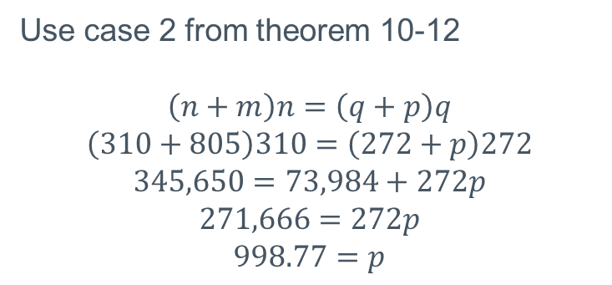
Example 4:
Archaeologists found part of the circular wall that surrounds an ancient city. They measure the distances shown. The 272m segment lies on a line through the center of the circular wall. What was the diameter of the circular wall?
Use case 2 from theorem 10-12
$$\left(n+m\right)n=\left(q+p\right)q$$
$$\left(310+805\right)310=\left(272+p\right)272$$
$$345,650=73,984+272p$$
$$271,666=272p$$
$$998.77=p$$

Slide 10
Book work:
Pg. 457 #12,14,16-18, 20-23, 25, 28, 29
Don’t forget to complete the required work through the online textbook.

