Slide 1
Unit 10 Circles
10.1 Day 1 - Arcs

Slide 2
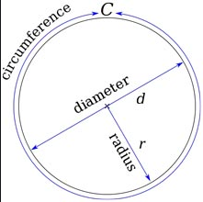
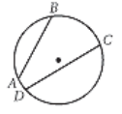
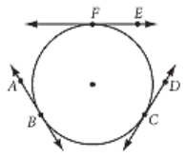
Quick Circle Term Review
The following terms should be in your comp book. Check to make sure, add any terms that are not there
Radius - the given distance from the center of the circle
Diameter - A diameter is a chord that passes through the center.
A diameter is the longest chord.
Chord - A chord is a line segment whose endpoints lie on the circle.
Tangent - A tangent is a line that intersects the circle only once.

Slide 3
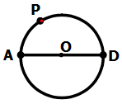



Quick Circle Term Review Cont.
Semicircle: an arc of a circle whose endpoints are the endpoints of a diameter.
Minor Arc: an arc of a circle that is smaller than a semicircle.
Major Arc: an arc of a circle that is larger than a semicircle
$$\hat{APD}$$
$$\hat{AP}$$
$$\hat{ADP}$$

Slide 4
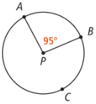


***Don’t forget to put all definitions in your comp book***
Intercepted arc: part of a circle that lies between two segments, rays, or lines that intersect the circle.
Example: There are 2 intercepted arcs in this picture
$$\hat{ACB}$$
$$\hat{AB}$$

Slide 5
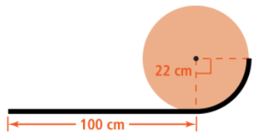
How would you answer this question?
(Introduction Question)
Darren bends a piece of wire using a circular disc to make the shape as shown.
How long does the piece of wire need to be to make the shape? Explain.
See the solution on the next page

Slide 6
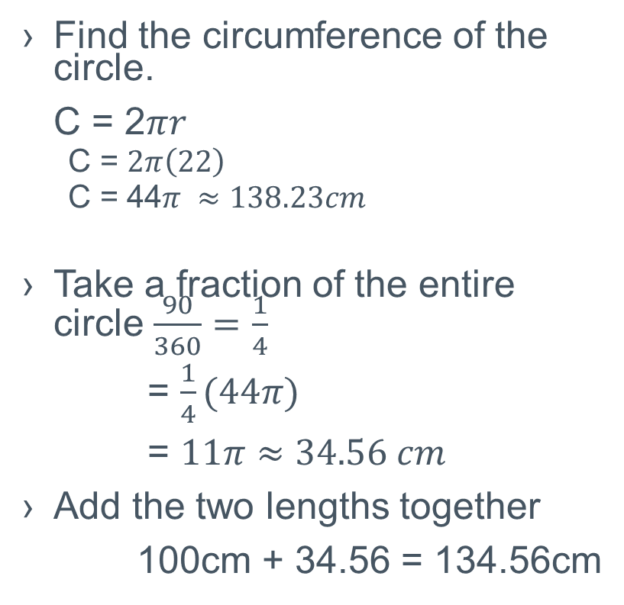
Solution
Find the circumference of the circle.
C = 2$πr$
  C = $2π\left(22\right)$
  C = 44$π ≈138.23cm$
Take a fraction of the entire circle $\frac{90}{360}=\frac{1}{4}$
= $\frac{1}{4}(44π)$
= $11π≈34.56 cm$
Add the two lengths together
100cm + 34.56 = 134.56cm
Can you figure out why I used the fraction ¼?
Hint: Did you look at the angle marking in the center of the circle. 90 is ¼ of 360.

Slide 7
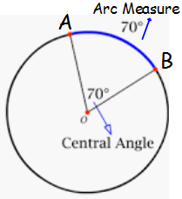
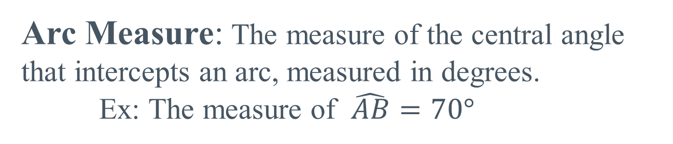
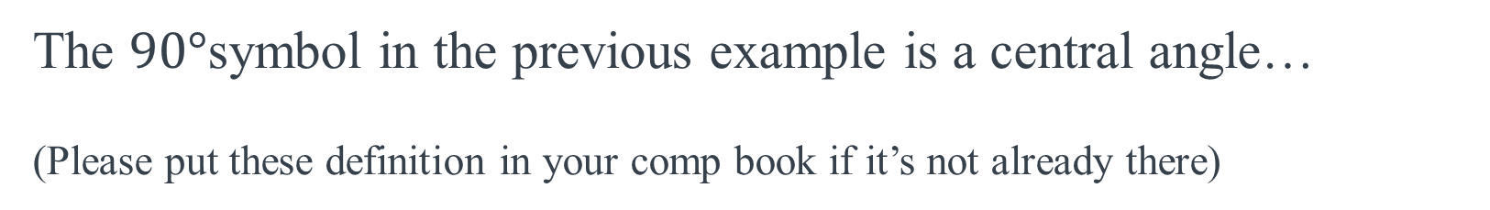
The $90°$symbol in the previous example is a central angle…
(Please put these definition in your comp book if it’s not already there)
Central angle: An angle whose vertex is the center of a circle and whose sides pass through the endpoints of an arc
Arc Measure: The measure of the central angle that intercepts an arc, measured in degrees.
Ex: The measure of $\hat{AB}=70°$
NOTE: the Central angle and arc measure have the same measurement

Slide 8
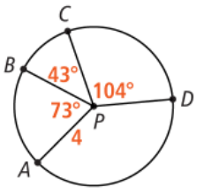

Example: Check UP
Solution:
$$\hat{AD}=140°$$

Slide 9
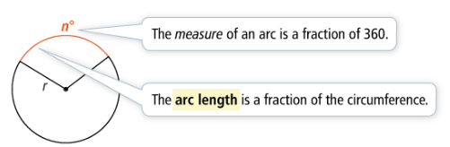
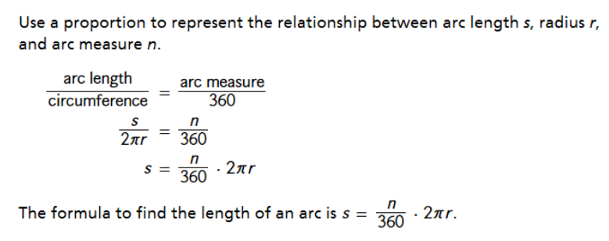
Arc Length - the fraction of the circumference of the circle
- the distance around a portion of the circle
How do you find the length of s of an arc measuring in degrees?

Slide 10
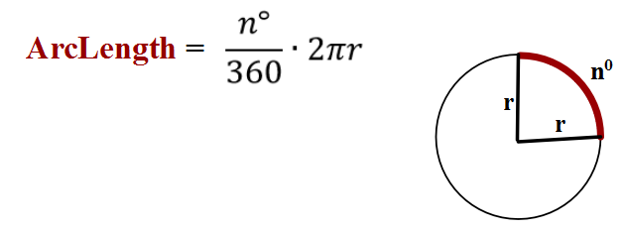



Arc Length Example:
r = 4cm, what is the length of an arc that has an arc measure of 80⁰?
Solution:
$$\frac{80}{360}2(π)(4)$$
$$\frac{2}{9}(8)π$$
$$5.59$$

Slide 11
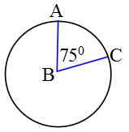

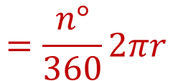
Arc Length vs. Arc Measure
Arc Length is a distance
Arc Measure is a degree measurement
$$=\frac{n°}{360}2πr$$
$$= 75°$$

Slide 12
Part 2…..
Tomorrow ☺

