Slide 1
Unit 10 Circles
10.1 Day 2 Sector and Segments

Slide 2
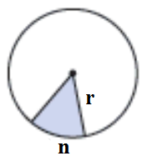


Sector of a circle
How do we find the area of the shaded region?
(Challenge yourself to take a guess before you reveal the solution)
It is a fraction of the entire circle.
Solution:

Slide 3
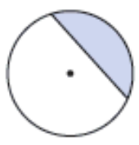
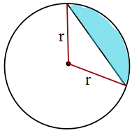
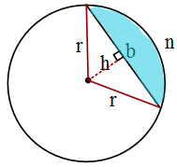


Segment of a Circle
Steps:
1.) Draw in radii to create a triangle
2.) Label the height and base of the triangle
3.) Find the area of the full sector
4.) Find the area of the triangle
5.) Subtract the two to find the remaining area.

Slide 4
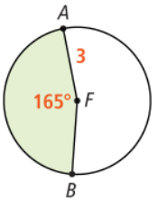


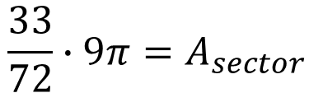
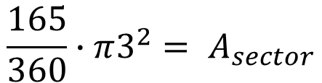

Let’s start with the area of the sector
Example 1:
$$n=165°$$
$$\frac{165}{360}∙π3^{2}= A_{sector}$$
$$\frac{33}{72}∙9π=A_{sector}$$
$$4.125π=A_{sector}$$
$$12.96≈A_{sector}$$

Slide 5
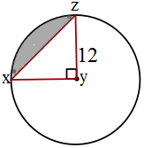


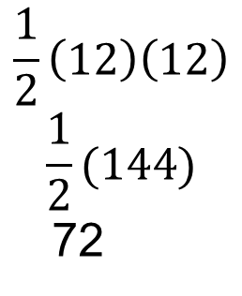
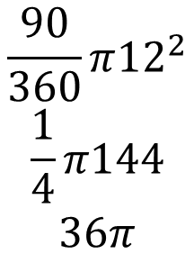
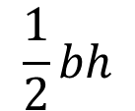
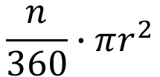
Example: 2
How about the area of a segment?
Side note: because this is a right triangle, the base and height are the same length.
$$\frac{n}{360}∙πr^{2}$$
$$\frac{1}{2}bh$$
$$\frac{90}{360}π{12}^{2}$$
$$\frac{1}{4}π144$$
$$36π$$
$$\frac{1}{2}\left(12\right)\left(12\right)$$
$$\frac{1}{2}(144)$$
72

Slide 6
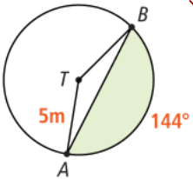
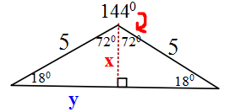
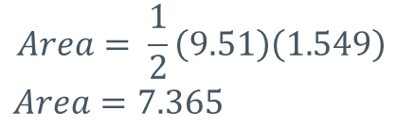




Example 3:
What about this one?
$$\sin{18}=\frac{x}{5}$$
$$\cos{18}=\frac{y}{5}$$
1) Find the area of the triangle
  In this picture, we don’t know the base or height of triangle ATB.
  Redraw the triangle, sketch in the height with a right angle. Bisect and T. Find x and y.
    Use trig ratios to identify x and y. Remember y is only ½ of the base.
    Use x and y to calculate the area of triangle ATB.
$$x=1.549$$
$$y=4.755$$
Height = 1.549
Base = 2(4.755) = 9.51
$$Area= \frac{1}{2}\left(9.51\right)\left(1.549\right)$$
$$Area=7.365$$
Cont. on the next page

Slide 7
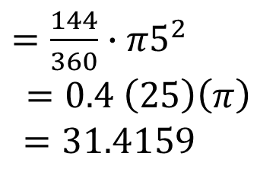
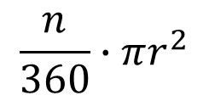
Example 3: What about this one? Cont.…
$$\frac{n}{360}∙πr^{2}$$
$=\frac{144}{360}∙π5^{2}$
$$=0.4 \left(25\right)\left(π\right)$$
$$=31.4159$$
2) Find the area of the sector
3) Subtract
4.) Final solution with units
Sector – Triangle = Area of Segment
31.4159 – 7.365 = 24.04
Area of Segment = 24.05 m

Slide 8
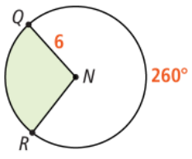
Example 4:
What is the area and perimeter of sector QNR?
Round to the nearest tenth.

Slide 9
Book Work: pg. 425 #11, 16-27 (not 21)
Remember, this is HW is not going to be turned in. (You can check your solutions in the Unit 10 Solutions page on the website.)

