Slide 1
10.2 Tangents
Day 1 and 2

Slide 2
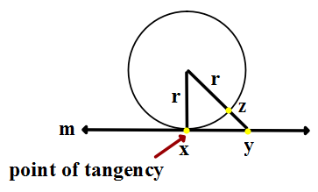
10.2 Tangent to a circle
***Remember – put all Definitions and Theorems in your comp book***
Tangent to a circle - a line in the plane of the circle that intersects the circle in exactly one point.

Slide 3
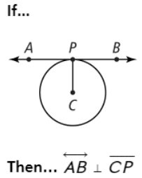
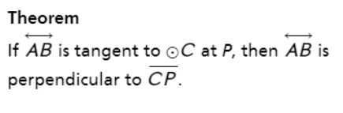
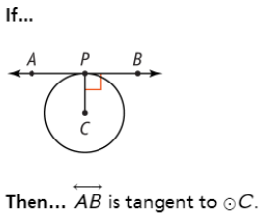
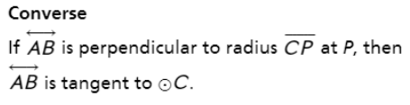
Theorem 10-1 Tangent Theorem
(and the converse)

Slide 4
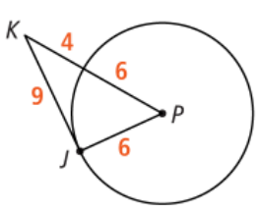

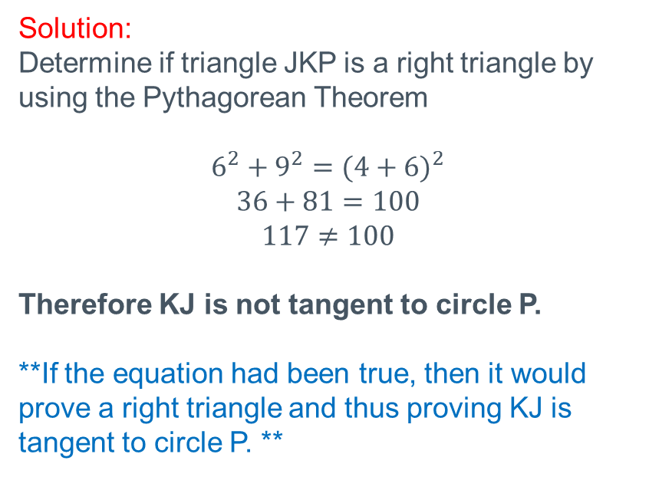
Example 1: Understanding Theorem 10.1
Solution:
Determine if triangle JKP is a right triangle by using the Pythagorean Theorem
$$6^{2}+9^{2}={(4+6)}^{2}$$
$$36+81=100$$
$$117≠100$$
Therefore KJ is not tangent to circle P.
**If the equation had been true, then it would prove a right triangle and thus proving KJ is tangent to circle P. **

Slide 5
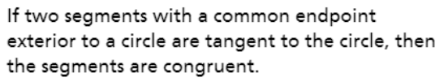
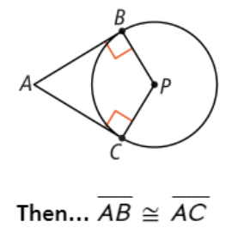
Theorem 10-2
Segments Tangent to a Circle Theorem

Slide 6

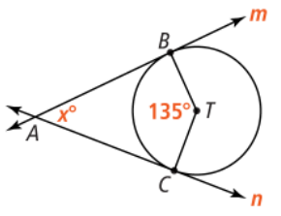
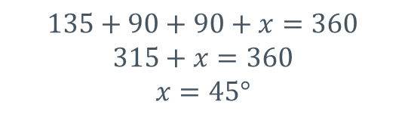
Example 2:
Solution:
$$135+90+90+x=360$$
$$315+x=360$$
$$x=45°$$

Slide 7
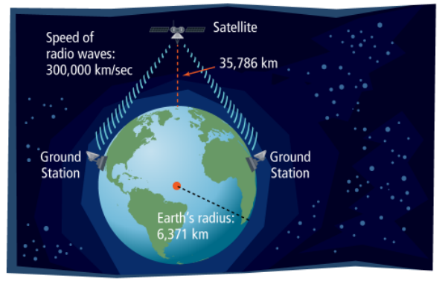
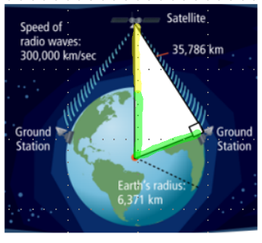
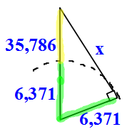
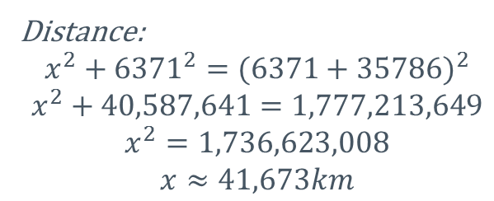
What does this look like and how is it used?
A satellite requires a line of sight for communication. Between the ground stations farthest from the satellite, what is the amount of time needed for a signal to go from one station up to the satellite, and then down to the other station?
Distance:
$$x^{2}+{6371}^{2}={(6371+35786)}^{2}$$
$$x^{2}+40,587,641=1,777,213,649$$
$$x^{2}=1,736,623,008$$
$$x≈41,673km$$

Slide 8
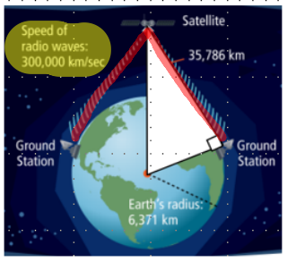
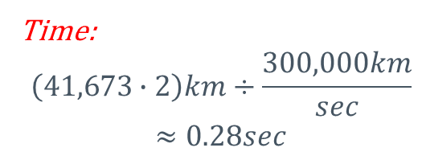
What does this look like and how is it used?
A satellite requires a line of sight for communication. Between the ground stations farthest from the satellite, what is the amount of time needed for a signal to go from one station up to the satellite, and then down to the other station?
Time:
$$\left(41,673∙2\right)km÷\frac{300,000km}{sec}$$
$$≈0.28sec$$

Slide 9
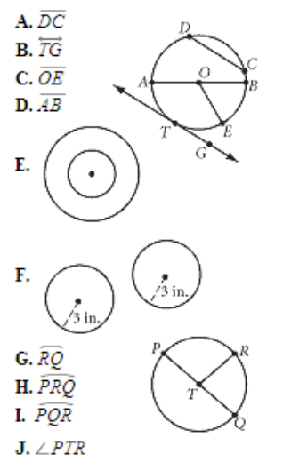
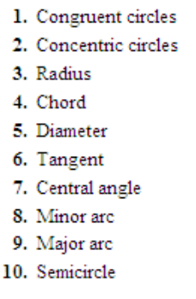
Quick Check-Up
Check you Vocabulary – Match each number with the correct letter
Solutions: 1. F, 2.E, 3.C, 4.A, 5.D, 6.B,
7.J, 8.G, 9.I, 10.H

Slide 10
Book Work:
Pg. 433 #11, 15-20, 22, 27
Remember, this HW is not going to be turned in. (Check your solutions in the Unit 10 Solutions page on the website)
HW that needs to be turned in: 10.1 MathXL Practice
(located online through your textbook)

